Slide 1
The Naturalist
How Southwest Native American Tribes Rely on Nature
By: Zander Selleseth

Slide 2
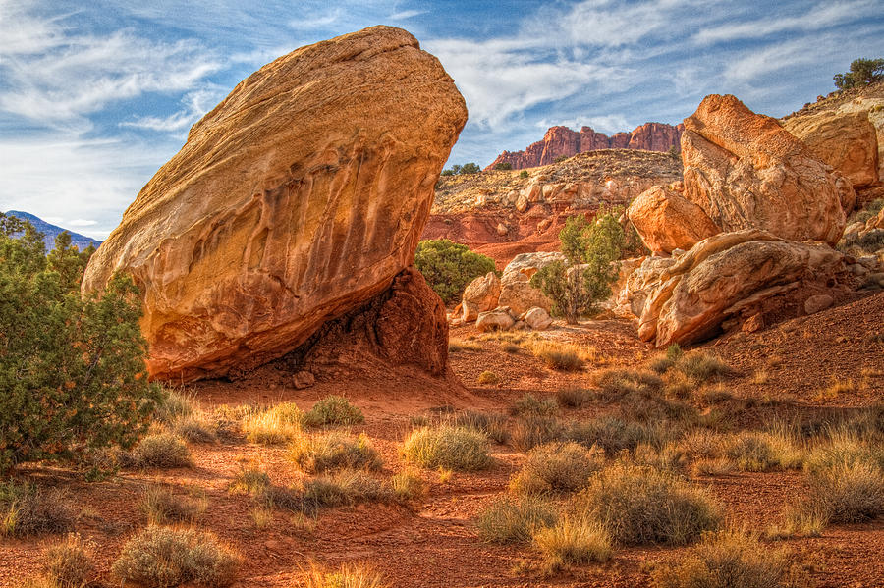
Introduction
Without nature, the Native American tribes of the southwest would not be able to survive in the harsh climate of their area. Since they did not have 21st-century devices, they had to use the land’s natural resources for their way of life. These tribes had to consider proximity to water, available building materials, soil quality, and domestic animals before selecting a place to live. This decision had to be made carefully as it would have a tremendous impact on their continued existence.

Slide 3
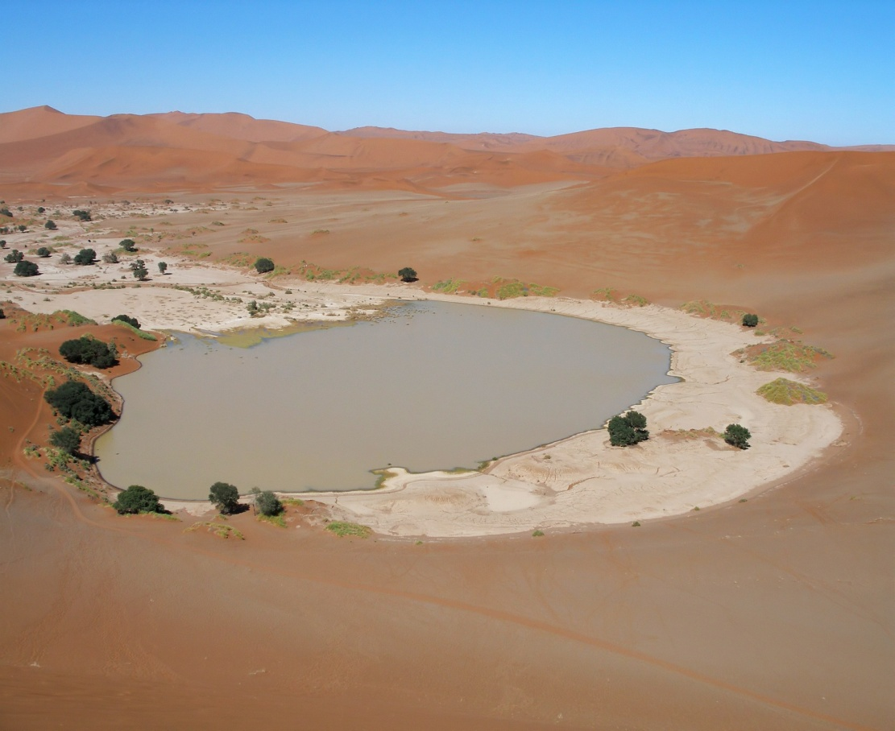
Location
The people of the southwest Native American tribes were very particular about where they chose to live. Since they basically lived in a desert, their communities tended to form near bodies of water. Water is an important resource that is scarce in the southwest region’s deserts, so it was vital to their survival.

Slide 4
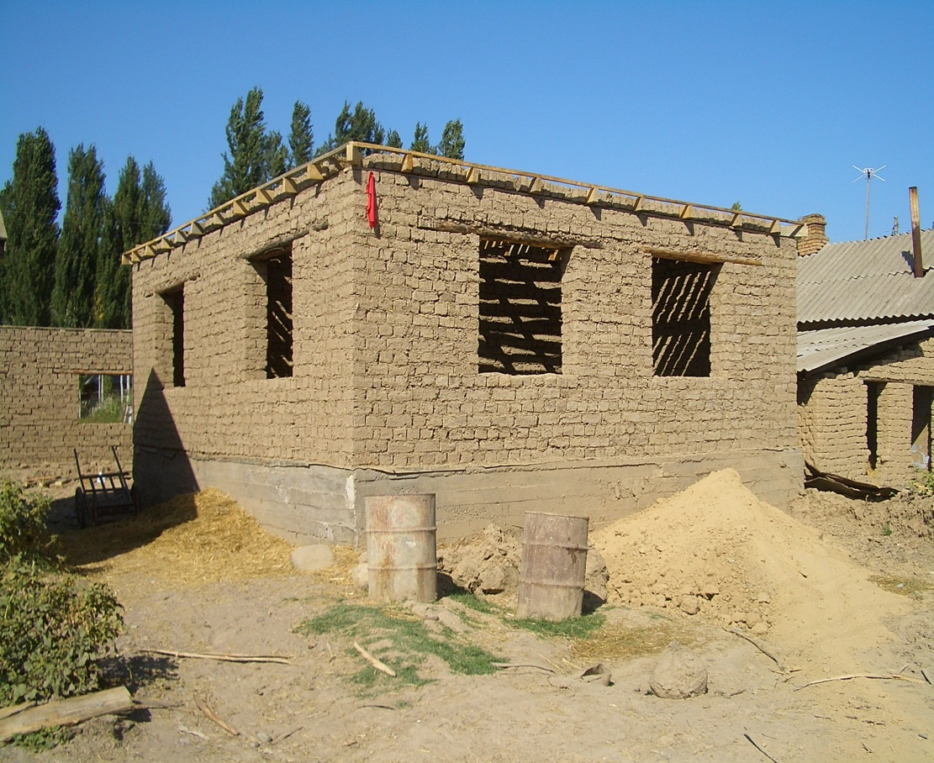
Shelter
Southwest tribes used their surroundings to make their homes. They did not have access to abundant sources of animal skins and wood like other regions. They took the mud and grass around them, made adobe bricks, and built their homes. These materials were common in their area, and they used it to their advantage.

Slide 5

Food
Southwest Native American tribes were hunters, gatherers, and farmers. They tended sheep and planted crops. The crops included maize, beans, squash, melons, pumpkins, and other fruit. However, food obtained from hunting and gathering was their main sustenance due soil conditions of the region.

Slide 6
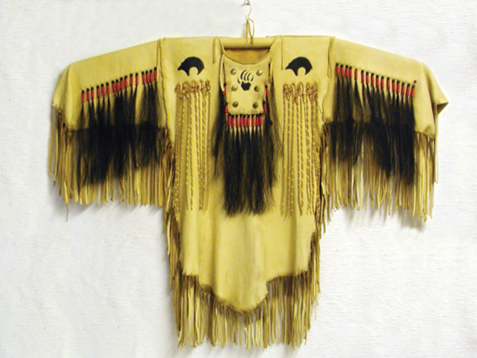
Clothing
The native tribes in the region got most of their clothes from wool. They farmed sheep, so this was a common resource. They made dye from natural elements, dyed the wool, and then wove it into beautiful patterns to make cloaks. Turquoise was available in the desert, so they strung it together to make jewelry.

Slide 7
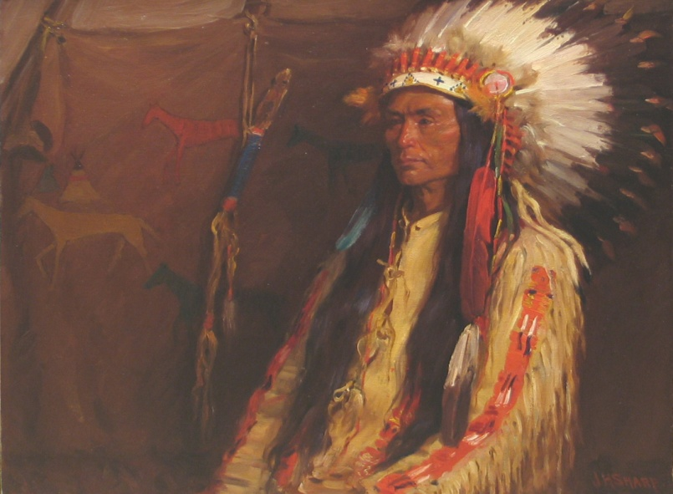
Conclusion
Nature had a significant impact on Southwest Native American tribal life. To them, the land was literally their life. They had to rely on natural resources to survive in the harsh climate in which they lived and provide basic necessities like shelter, food, and clothing. These tribes adapted their way of life to the environment in which they lived in order to sustain their population for generations to come.

